Slide 1
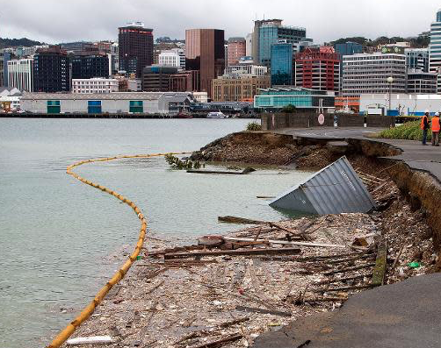
Wellington Earthquakes: An Investigation
IOD Data Science Capstone Project – August 2024
Jeremy Roscoe

Slide 2

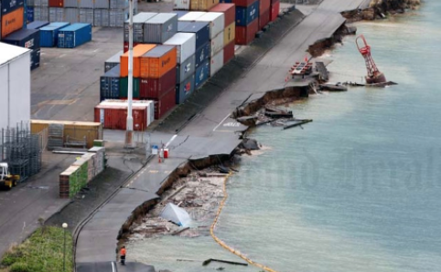







Agenda
Bio
Project Context
Problems
Approach
EDA
Modelling
Outcomes
Insights
Growth

Slide 3



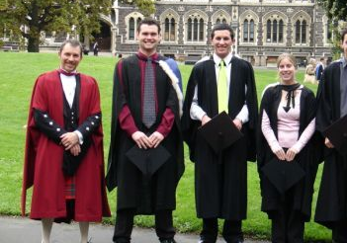
Bio: Jeremy Roscoe
BA (Mathematics) Otago University
BSc(Chemistry) Otago University
Worked in Chemical laboratories, Processing plants, Wineries, Restaurants , Mine sites
Travelled to Australia working as a chef
Have completed an R-based data-science specialization through John Hopkins University
Grew up in earthquake prone Hawkes Bay

Slide 4
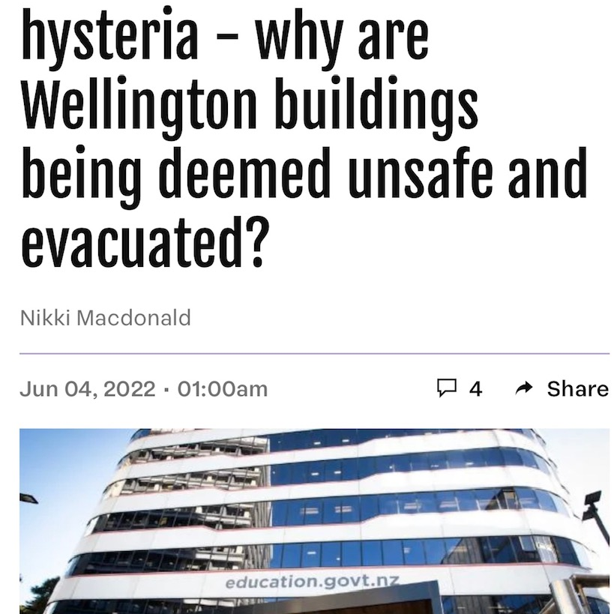
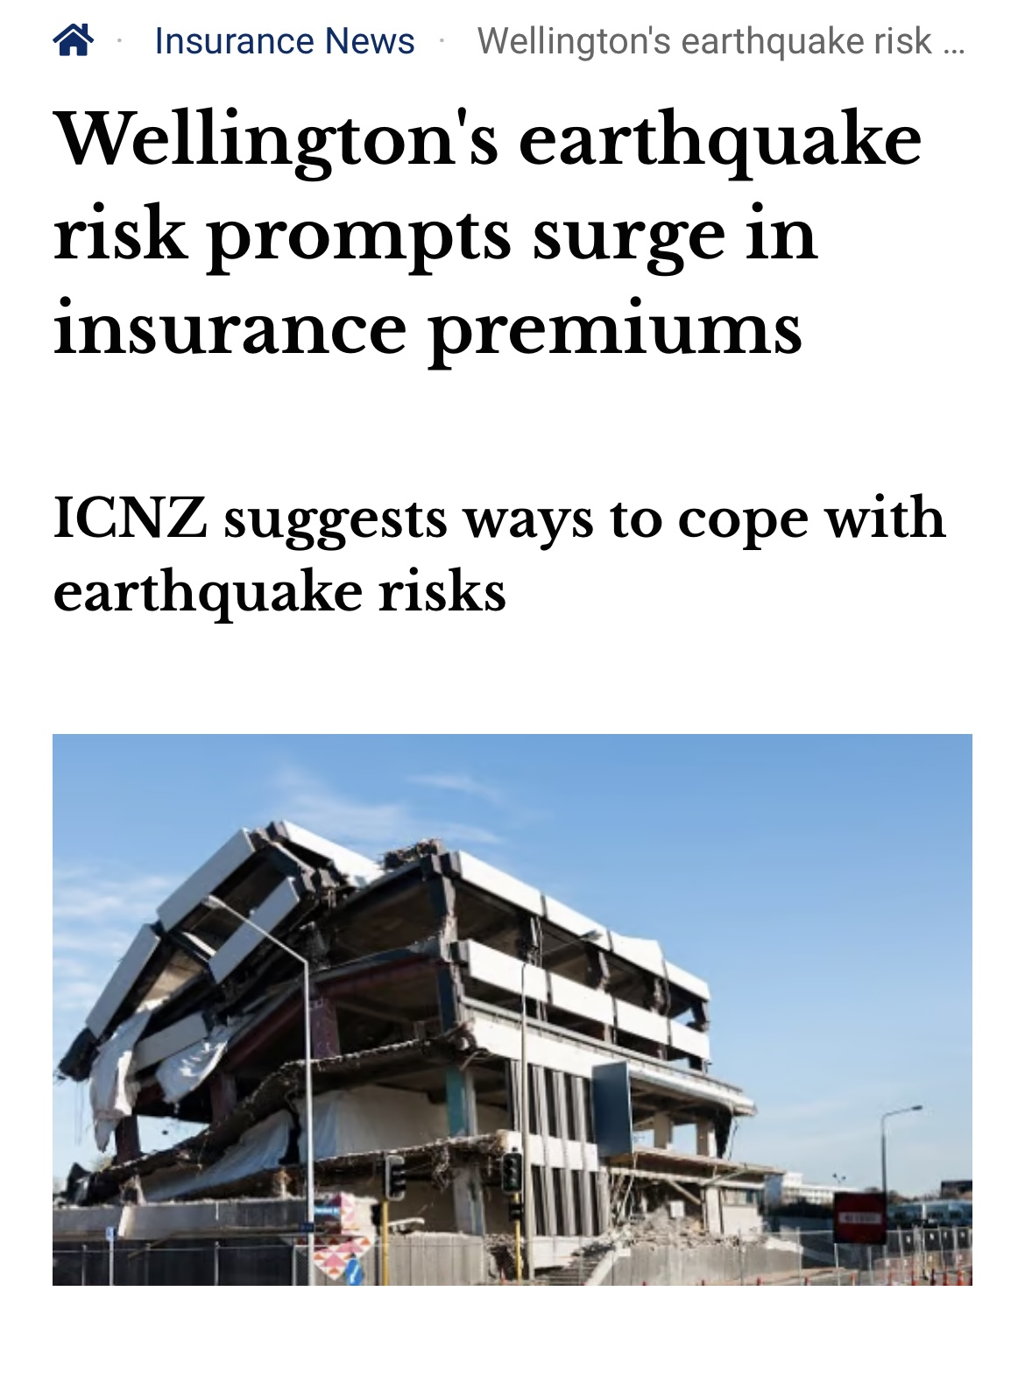
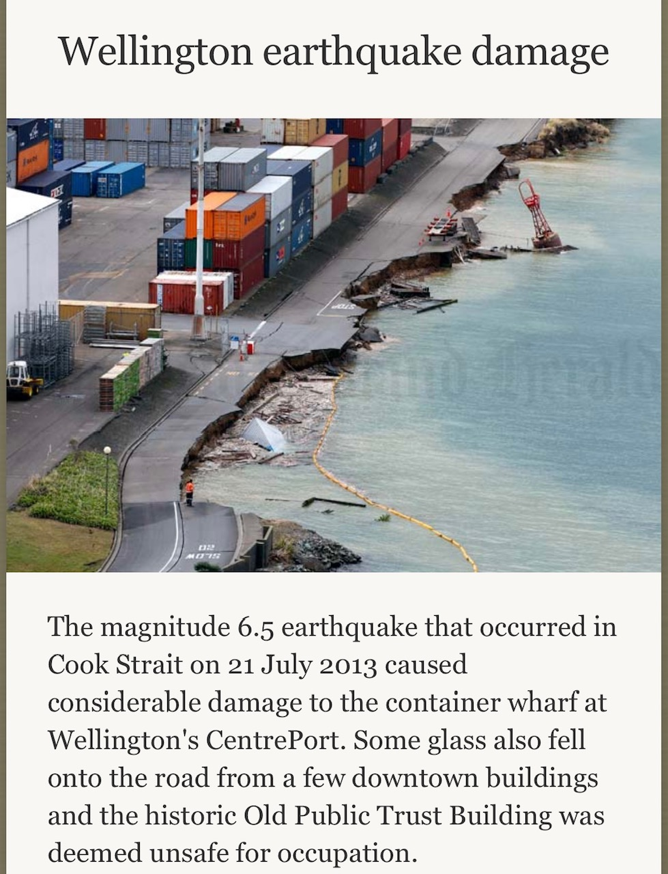

Project Context
Earthquakes are increasingly causing damage to Wellington’s infrastructure
Regulations continually need updating to ensure safety though are outpacing the ability to meet them
Seismic events are currently monitored and investigated with warnings issued of potential aftershocks
Currently no reliable forecasting
Notes:
Whilst many industries have a vested interest in this domain particularly city planners, government bodies, insurance companies and structural engineers. It is the team at GNS who are responsible for geohazard monitoring investigation and alerts

Slide 5
Problems:
The Business Problem:
Can we find a way to make predictions on upcoming seismic events to better prepare for the impacts, improve response times, and estimate risk?
The Data Problem:
From existing Wellington region earthquake data, can patterns and relationships be exploited for the prediction of future seismic events?
What will be the magnitude of the next event
How much vibrational energy is going to be released into the region over a future window
Will the next event cause significant damage (magnitude >= 5.0)
Notes:
At this point I would like to mention that whilst the investigation aims to solve these problems, it is an ongoing task, and the work here is a 2 week milestone

Slide 6

Approach
Data Sourced from Geonet (WFS)
Cleaning and EDA
Clustering Investigation
Time Series Analysis
Pattern Recognition
Rolling window feature generation
Regression modelling
Model evaluations
Classification modelling

Slide 7
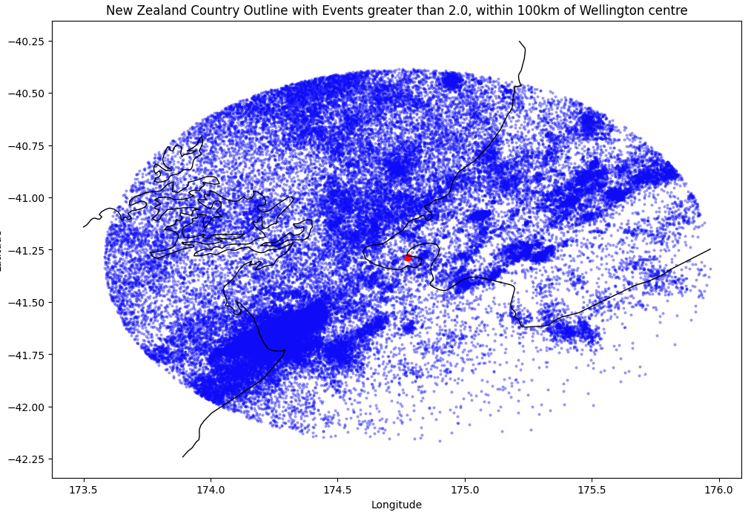
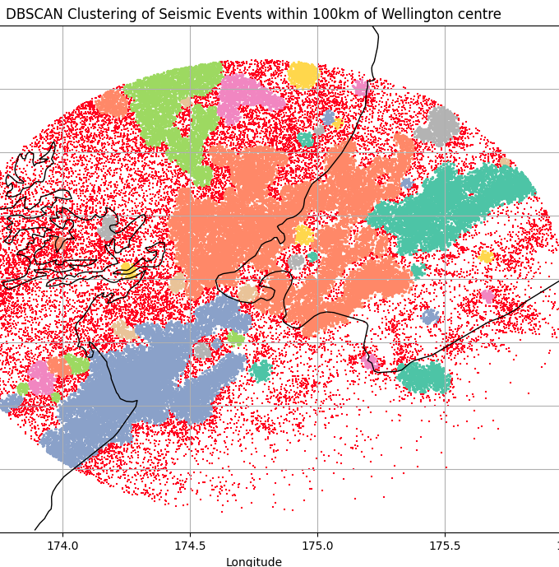
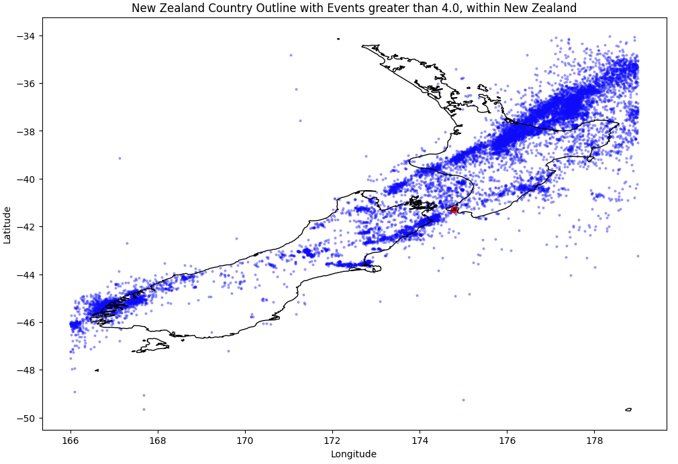
Data Exploration:
Event Distribution and Clustering

Slide 8
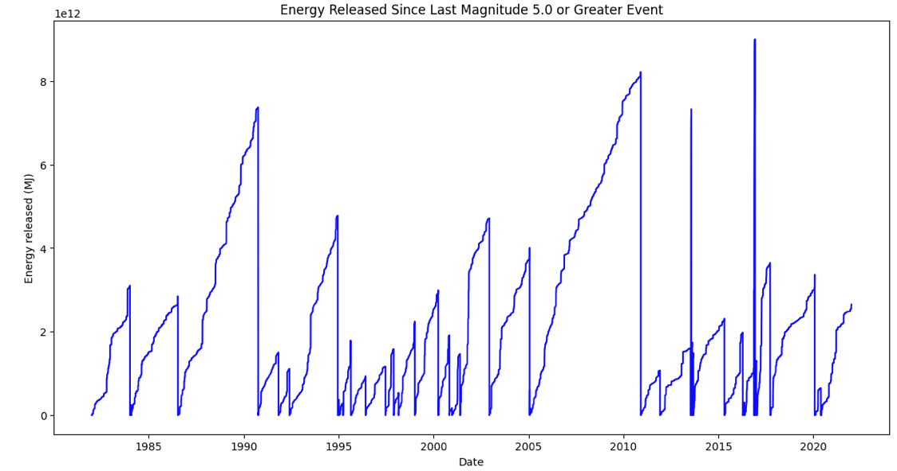
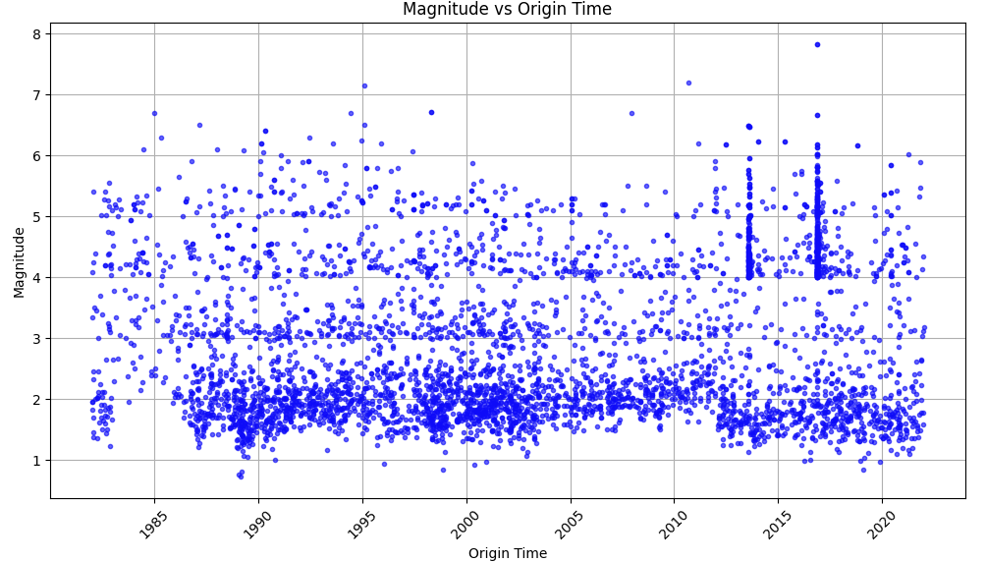
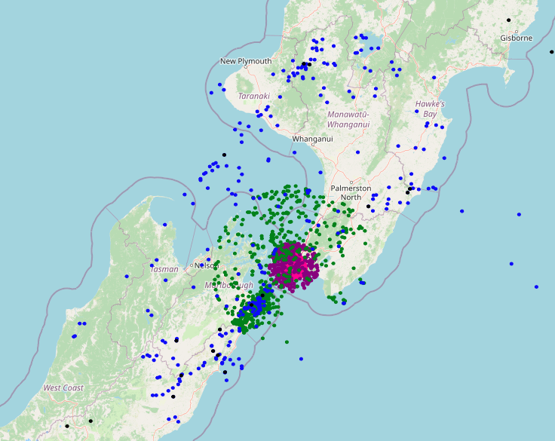
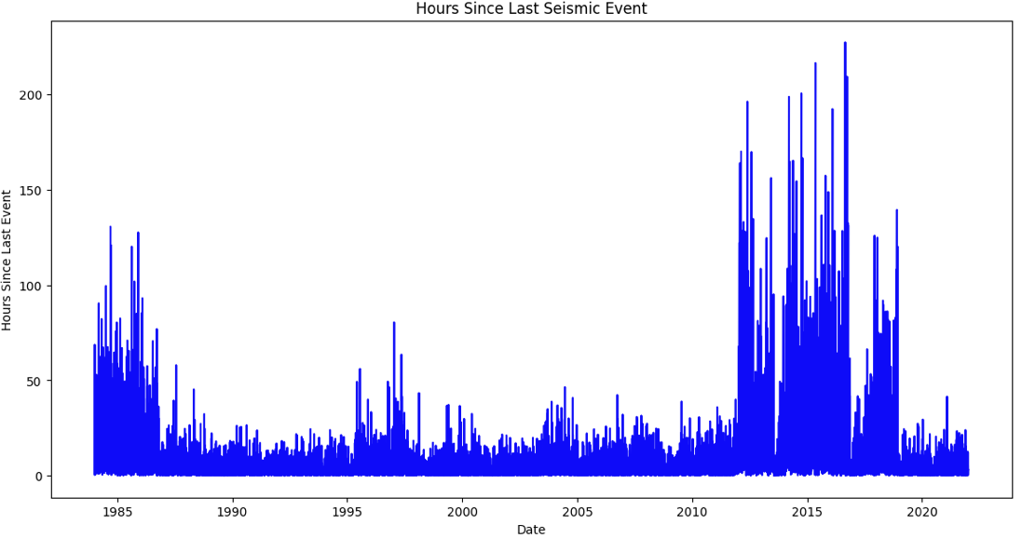
Patterns in observations:
Events affecting Wellington City
-Tiered by magnitude and distance
Notes:
* Note the inconsistency in energy release since the last major event
* Also note the apparent banding in the magnitude distribution
* and the dense spikes either side of 2015
* The hours since last event shows an interesting pattern that comes up again later

Slide 9
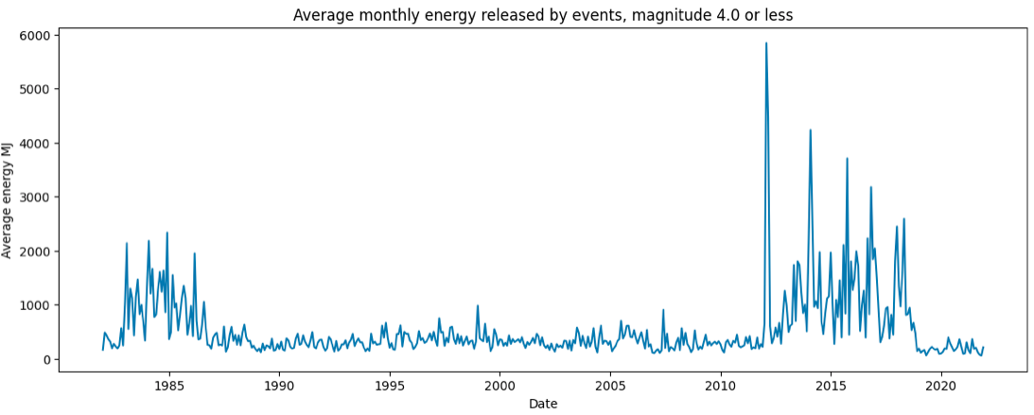
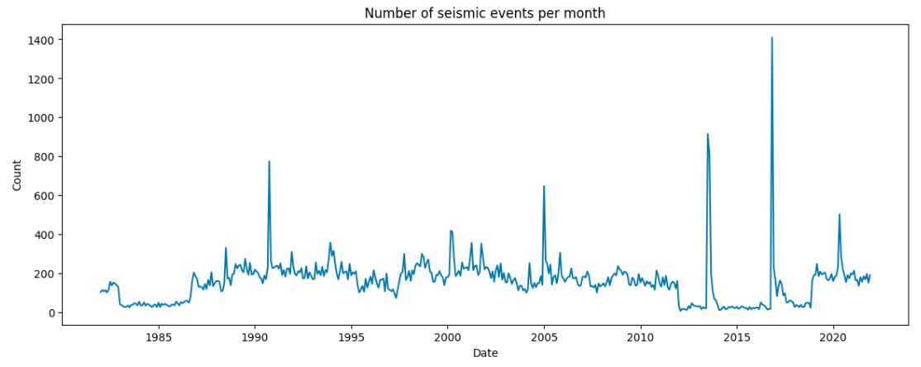
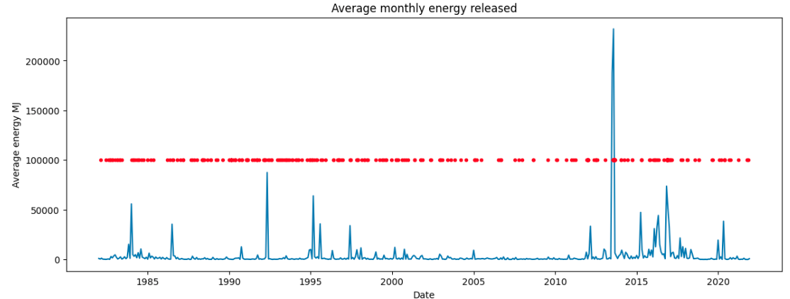
Patterns: Monthly Aggregations
Appears to be a recurring pattern of periods of high energy release lasting about 6 years with centres about 32 years apart
These periods appear to coincide with a significant drop in event frequency (excluding spikes)
Notes:
Note how the chart shown previously has some similarities with the average monthly energy releases
The bottom chart is overlayed with external event timings that affect the region of interest

Slide 10
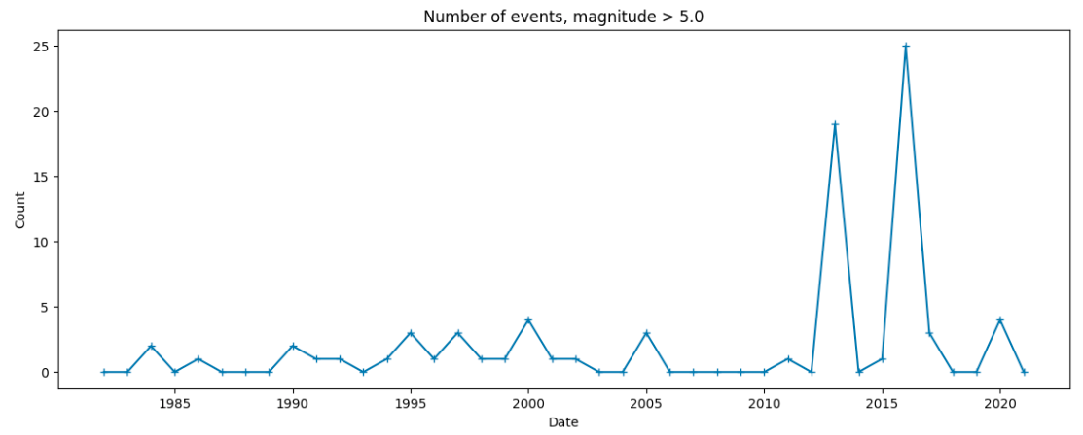
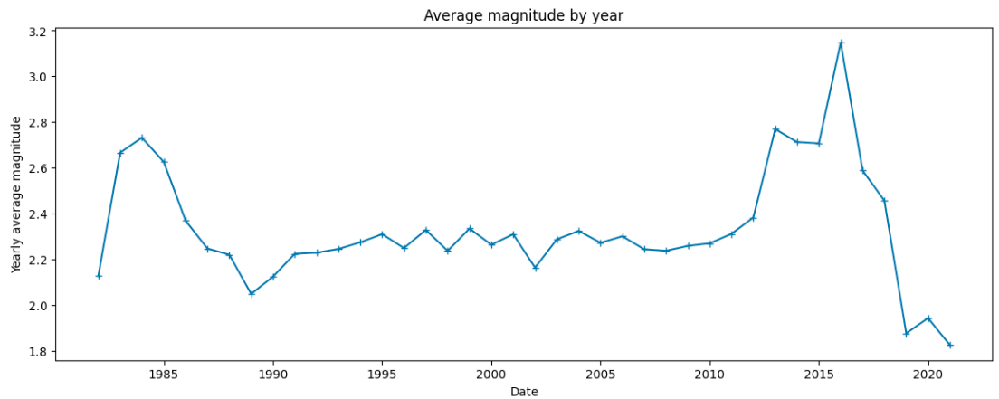
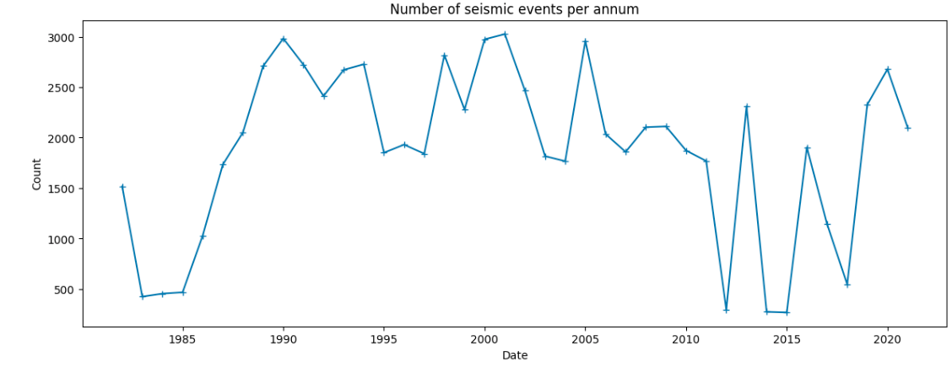
Patterns: Annual Aggregations
When annual event frequency drops the average magnitude increases
From 2010 on, there are more “big” events

Slide 11
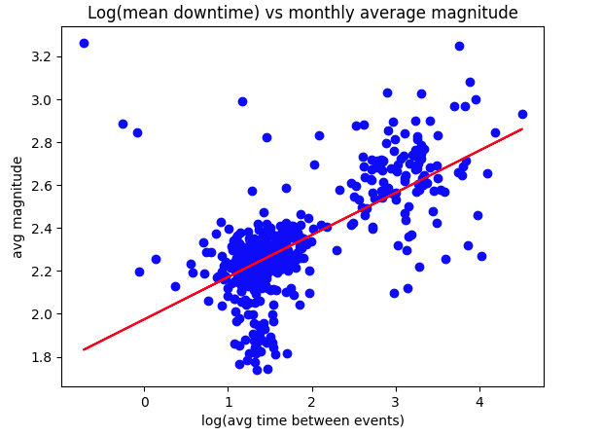
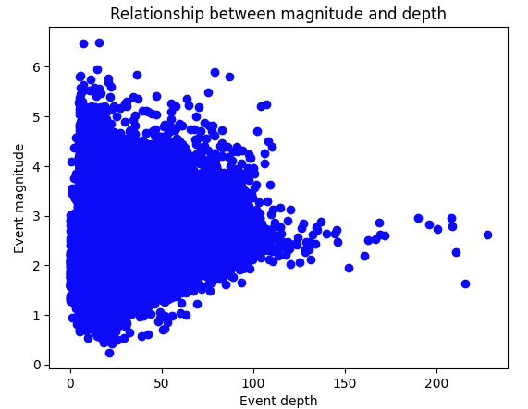
Notable Relationships:
The range of magnitudes decreases as depth increases
There appears to be a linear relationship between the log of mean downtime and the average magnitude.

Slide 12


Modelling:
Linear Regression
Support Vector Regression
Random Forest regressor and classifier
Light Gradient Boosting Machine regressor and classifier
Elastic Net Regression
Logistic Regression
Decision Tree Classifier
Stacking
GridSearch parameter tuning
Input stratification techniques
Predicting:
Next Event Magnitude
Total energy released in the next 20 days
Next event >= 5.0

Slide 13
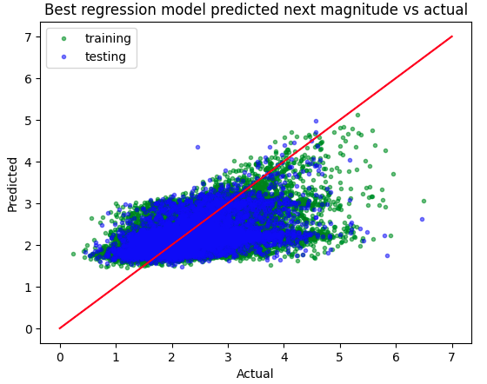
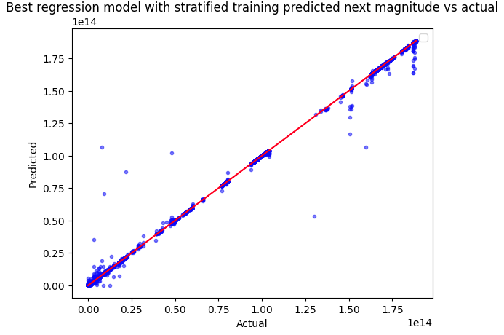
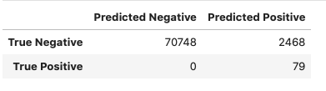
Outcomes:
Regression tasks:
Magnitude prediction
Best model: Support Vector Regressor with C=1 and unstratified input for training
Classification task:
Big event prediction
64% categorical accuracy within tolerance of 0.4
Best model: LGBM classifier with recall as primary objective and stratified input for training
98% accuracy with 100% recall
20-day energy forecasting
Best model: Random Forest Regressor with unstratified input for training
99.9% R-squared with MAPE 13.7%
Notes:
The ability to predict all big events whilst maintaining 98% accuracy will benefit allocation of emergency services and preparedness for the populous

Slide 14
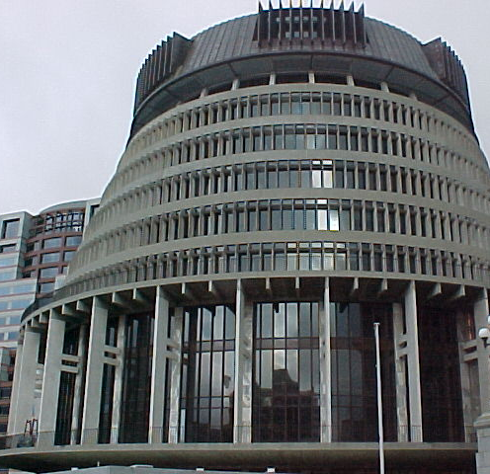
Insights:
There is potential for forecasting in this domain
More feature tuning is required to improve predictability
It is easier to predict a window than a next event (99% vs 64%)
Clustering factors may improve performance
Introducing effects of external events may expand robustness
Predicting the next magnitude may not be as valuable given most events are minor
Further work is required before definitive answers to the business and data questions can be made

Slide 15

Growth:
Explore fault system proximity clustering as a feature
Expand model training to include external influencing events
Expand the training window beyond 40 years
Streamline a pipeline from raw data to predictions
Evaluate predictions on current data: 2022 - now
Explore the use of neural network models
Thank-you

